Slide 1
Roles & Responsibilities of Sector Officers

Slide 2
Contents of the Presentation
S. No. | Name of the Topic | Slide Numbers
1. | Overall objective | 3-4
2. | Learning Points | 5
3. | Pre- Poll role and responsibilities | 6-68
4. | Poll Eve role and responsibilities | 69-73
5. | Poll Day role and responsibilities | 74-128

Slide 3
Role & Responsibilities of Sector Officers
Categorisation under three phases:
Pre-Poll
On the Poll Eve
On the Poll Day

Slide 4
Overall objective
To provide clarity to Sector Officer on
Election Management
Law & Order and Complaint management
Model Code of Conduct
Election Expenditure Monitoring
Polling Process
Functioning of EVM-VVPAT
Coordination
SVEEP
Other important aspects of election

Slide 5
Learning Points
Roles
Responsibilities and Authorities
Model Code of Conduct
Selection and finalization of polling locations
Conduct of vulnerability mapping
Functioning of EVM-VVPAT
SVEEP
Conduct of mock poll
Tasks during poll day
Knowledge of relevant laws
Required Resources
Reports to be furnished by Sector Officer
Law and Order and Complaint management
Set of various relevant instructions issued by competent authority and its operational period

Slide 6
Role & Responsibilities of Sector Officers – Pre-Poll

Slide 7
Role of Sector Officers – Pre-Poll
The Key Election manager drawn from amongst the best lot of officials, whose roles demand huge functional responsibility and managerial skill and knowledge .
Responsible for multifarious aspects of election management from the day of appointment till the completion of poll process .
Zonal/Sector Magistrates for the same area when provided with powers of Special Executive Magistrates .

Slide 8
Some important points
Sectors to be constituted well in advance.
Immediately after the appointment, Sector Officer should prepare the sector map.
Routes should be plotted on sector map.
DEO/RO & Observers will have review meetings with SOs and monitor works allotted to and done by them.
To be provided with mobility support.
To ensure effective implementation of communication plan.

Slide 9
Preparation of Sector Plan
A manageable route covering 10-12 polling stations or 4-5 Polling Station Location(PSL) as may be convenient.
Civil Sector- cluster of polling stations of a single AC/AS with geographical contiguity and convenient communication network for mobility.
To be formed in consultation with the police in order to make it co-terminus with the police sector.

Slide 10
Components of Sector Plan
Polling stations categorized by no. of voters.
Availability of AMF in a polling station as per physical verification report & action to be taken thereof
Movement plan for polling parties with route charts.
Sketch Map of sector with marking of vulnerable hamlets, mobile shadow zone, geographical barriers and communication network like road, railways, etc.
Assessment of vehicle requirements.
Communication plan including mobile/internet shadow zone.

Slide 11

MOVEMENT PLAN
Sketch Map of Constituency showing Sector routes
Polling Station-4
Polling Station-1
Various Routes to reach Polling stations
40 km - 1 Hr.
Polling Station-5
Alternative Routes to reach Polling stations
20 km - 30 Min.
Polling Station-3
Shortest Routes to reach Polling stations
Polling Station-2
5 km - 10 Min.
Polling Station-6
Road Condition, River, Nala, Bridge
10 km - 20 Min.
Approximate time to reach and distances

Slide 12
Communication plan
It should contain –
DEO, RO,AROs landline/mobile nos.
DISTRICT LEVEL HELPLINE(24X7) for complaint monitoring
List of landline and cellular connections available near each PS
Identification of mobile shadow zone
To coordinate and ensure connectivity in mobile shadow regions
Identification of first referral point and ambulance in case of hospital need of a polling personnel.

Slide 13
Pre-Poll: Resources Required
Elaborate training on various roles in election.
Special Executive Magisterial powers on duty for 7 days (upto poll day).
A detailed map of his/ her sector.
A vehicle and fuel well in advance
The list of notified polling stations in his area.
Details about the voter help lines existing in his sector.

Slide 14
Pre-Poll: Resources Required
Identity card issued by DEO.
Communication Plan.
All notifications issued by competent authorities under various laws
An EVM for demonstration before the voters for awareness generation.
A route map of his sector, giving the broad layout and location of polling stations falling in his sector

Slide 15
Functions
Relating to:
Polling stations
Voters awareness and SVEEP
EVM-VVPAT awareness
Field level monitoring of MCC
Vulnerability Mapping, Criticality Analysis and sensitive polling stations and Confidence Building Measures (CBM)

Slide 16
Polling stations

Slide 17
Shifting of polling stations
Identification of suitable alternative polling stations, for cases, where voter is required to walk more than 2 kms in plain areas/ polling station is not located at the ground floor/better accommodation is available etc.
To be submitted to DEO in due manner
DEO to take up for disposal and seek approval of ECI

Slide 18
Assured Minimum Facilities (AMF) at polling stations
Election Commission has directed that voter friendly facilities and amenities should be provided at polling stations.
The following Assured Minimum Facilities (AMF) to be checked
at each polling station :-
Permanent Ramps with hand rail
Provision for drinking water
Separate Toilet for Men & Women
Electricity
Adequate furniture
Proper signage
Shades
Separate Entry and Exit
Help Desk
Good Approach Road

Slide 19
Polling station to have a minimum area of 20 sq. meters so that there is no congestion inside the polling station .
Maximum distance to be covered by an elector to be not more than 2 km.
Separate queues for men and women.
Old, infirm, pregnant women and differently abled persons (PWD) should be allowed to enter the polling station without having to stand in the queue.
Verify whether route plotted on map is feasible - Ascertaining the approach and accessibility.
Ensure that wide publicity is given to new polling stations.

Slide 20
Voter awareness & SVEEP

Slide 21
Inform voters about scope of inclusion, modification through continuous updation of electoral process,
Facilitate through BLOs and Electoral Literacy Clubs(ELCs),
Coordinate with institutions having ELC and with particular emphasis on issues relating to the PWD electors,
To facilitate coverage of all eligible voters through effective SVEEP programme

Slide 22
Give attention to low VTR pockets
Take remedial measures thereof.
Take lead role in awareness generation about Call centre facilities and helpline
To inform voters to check their names and entries in PER on website or through SMS system or through BLO

Slide 23
EVM-VVPAT matters

Slide 24
Awareness on EVM-VVPAT.
Coordinating the segregation of poll and training/awareness EVM-VVPATs through 1st Randomization in presence of political parties.
Coordinating the storage of FLC-ed EVM-VVPATs in the warehouse under fool proof 24x7 security and CCTV coverage.

Slide 25
Model code of conduct

Slide 26
Meetings with permission (only through SUVIDHA )
Coordinating coverage by MCC team & VST
coordinating PROCESSIONS- APPROPRIATELY COVERED by VST
Monitoring Use of vehicles- only with express permission from the CEO/DEO/RO
Action on wall-writing/ postering/ other form of canvassing
Restriction on use of loudspeakers as per orders

Slide 27
RESTRICTIONS
NO ADVERTISEMENT ON
  building/ structure owned by the state/ central government/ any local authority
  buildings/ fence of an educational institution or hospital
  buildings used for religious purpose
  gate or exit requirement of any building
  electrical installations (transformer, lamp post etc.)
  water supply installations
  public transport
  heritage buildings
  road, if that obstruct traffic/pedestrial movement

Slide 28
RESTRICTIONS
Advertisements on private buildings allowed
  With written permission from the owner
  When it does not obstruct
    Doors
    Windows
    Ventilation shaft
    Chimney
    AC
    Balcony
    Any other portion covered with iron grill

Slide 29
Pre Poll Responsibility: About Model Code of Conduct
Check On Wall Writings, Posters, Banners, Other Campaign Materials In Violation Of MCC/ Local Laws In Force
Report Unauthorized Use Of Govt. Property/ Premises,
Report whether any office of Political Party exists within 200 meters periphery of Polling Stations
Reporting any other instance of violation of Model Code of Conduct
Notes:
o

Slide 30
ACTION AGAINST VIOLATION
If not complied within 3 days, FIR to be lodged by RO, case registered by OC & the RO arranges removal
RO issues notice to the party/ candidate for removal
SDPO/ Dy.S.P report to RO/ DEO
SO, OC- PS to monitor & identify cases of violation/ report to SDPO/ Dy.S.P

Slide 31
Law & Order

Slide 32
Frequent visits and holding wide spread discussions with the people for confidence building measures and fine tuning the vulnerability mapping, by collecting intelligence;
Identification of villages, hamlets, segments and sections of voters vulnerable for threat and intimidation Identification of persons who make it vulnerable - It is not about numbers-it is about names
Information to be given in prescribed format for each such location / pocket separately to the RO/DEO without having to disclose the source, retaining a copy with him.
Accountability for ensuring free access of voters for voting.
Contact points within the vulnerable community with their telephone numbers

Slide 33
SO will act as Sector Magistrate/Zonal Magistrate accompanied by police officer.
Since SO will act as Sector Magistrate/Zonal Magistrate, he will prepare a Zonal Magistrate Plan with a sketch map for PSs, list of telephone Nos of PSs and election related officers, police stations, list of responsible persons, list of Anti Social elements etc.

Slide 34
PROVIDING INPUTS FOR PLANNING FOR LAW & ORDER MEASURES
VULNERABILITY MAPPING
IDENTIFICATION OF VULNERABLE AREAS
FORCE DEPLOYMENT PLAN FOR VULNERABLE AREAS
CRITICALITY ASSESSMENT
IDENTIFICATION OF CRITICAL POLLING STATIONS
FORCE DEPLOYMENT PLAN FOR CRITICAL POLLING STATIONS

Slide 35
VULNERABILITY MAPPING
Identify vulnerable areas, polling station-wise
Identify source of threat/ intimidation
Identify names of persons likely to spearhead such offence of undue influence
Take into cognizance past incidents and present apprehensions
Identify points of contact within the vulnerable community
Initiate preventive/ confidence building measures

Slide 36
ACTION POINTS ON VULNERABILITY MAPPING
Identification of Sectors- Civil & Police
Civil & Police Sector must be co-terminus
Extensive movement by DEO,RO,ARO,SDM,BDO/Tehsildar, Senior police officer for Confidence Building Measures ( CBM) in vulnerable areas & interactions with the common people thereof
Visits to be videographed
Available forces to be tagged with the visits

Slide 37
Preparation of VM reports
3 Phase reports to be prepared to identify:
Pockets of vulnerability
Intimidators as apprehended by the voters to affect free & fair election
VM-SO
VM- RO
VM-DEO
All reports to be compiled ,cross verified & action taken to remove cause of vulnerability

Slide 38
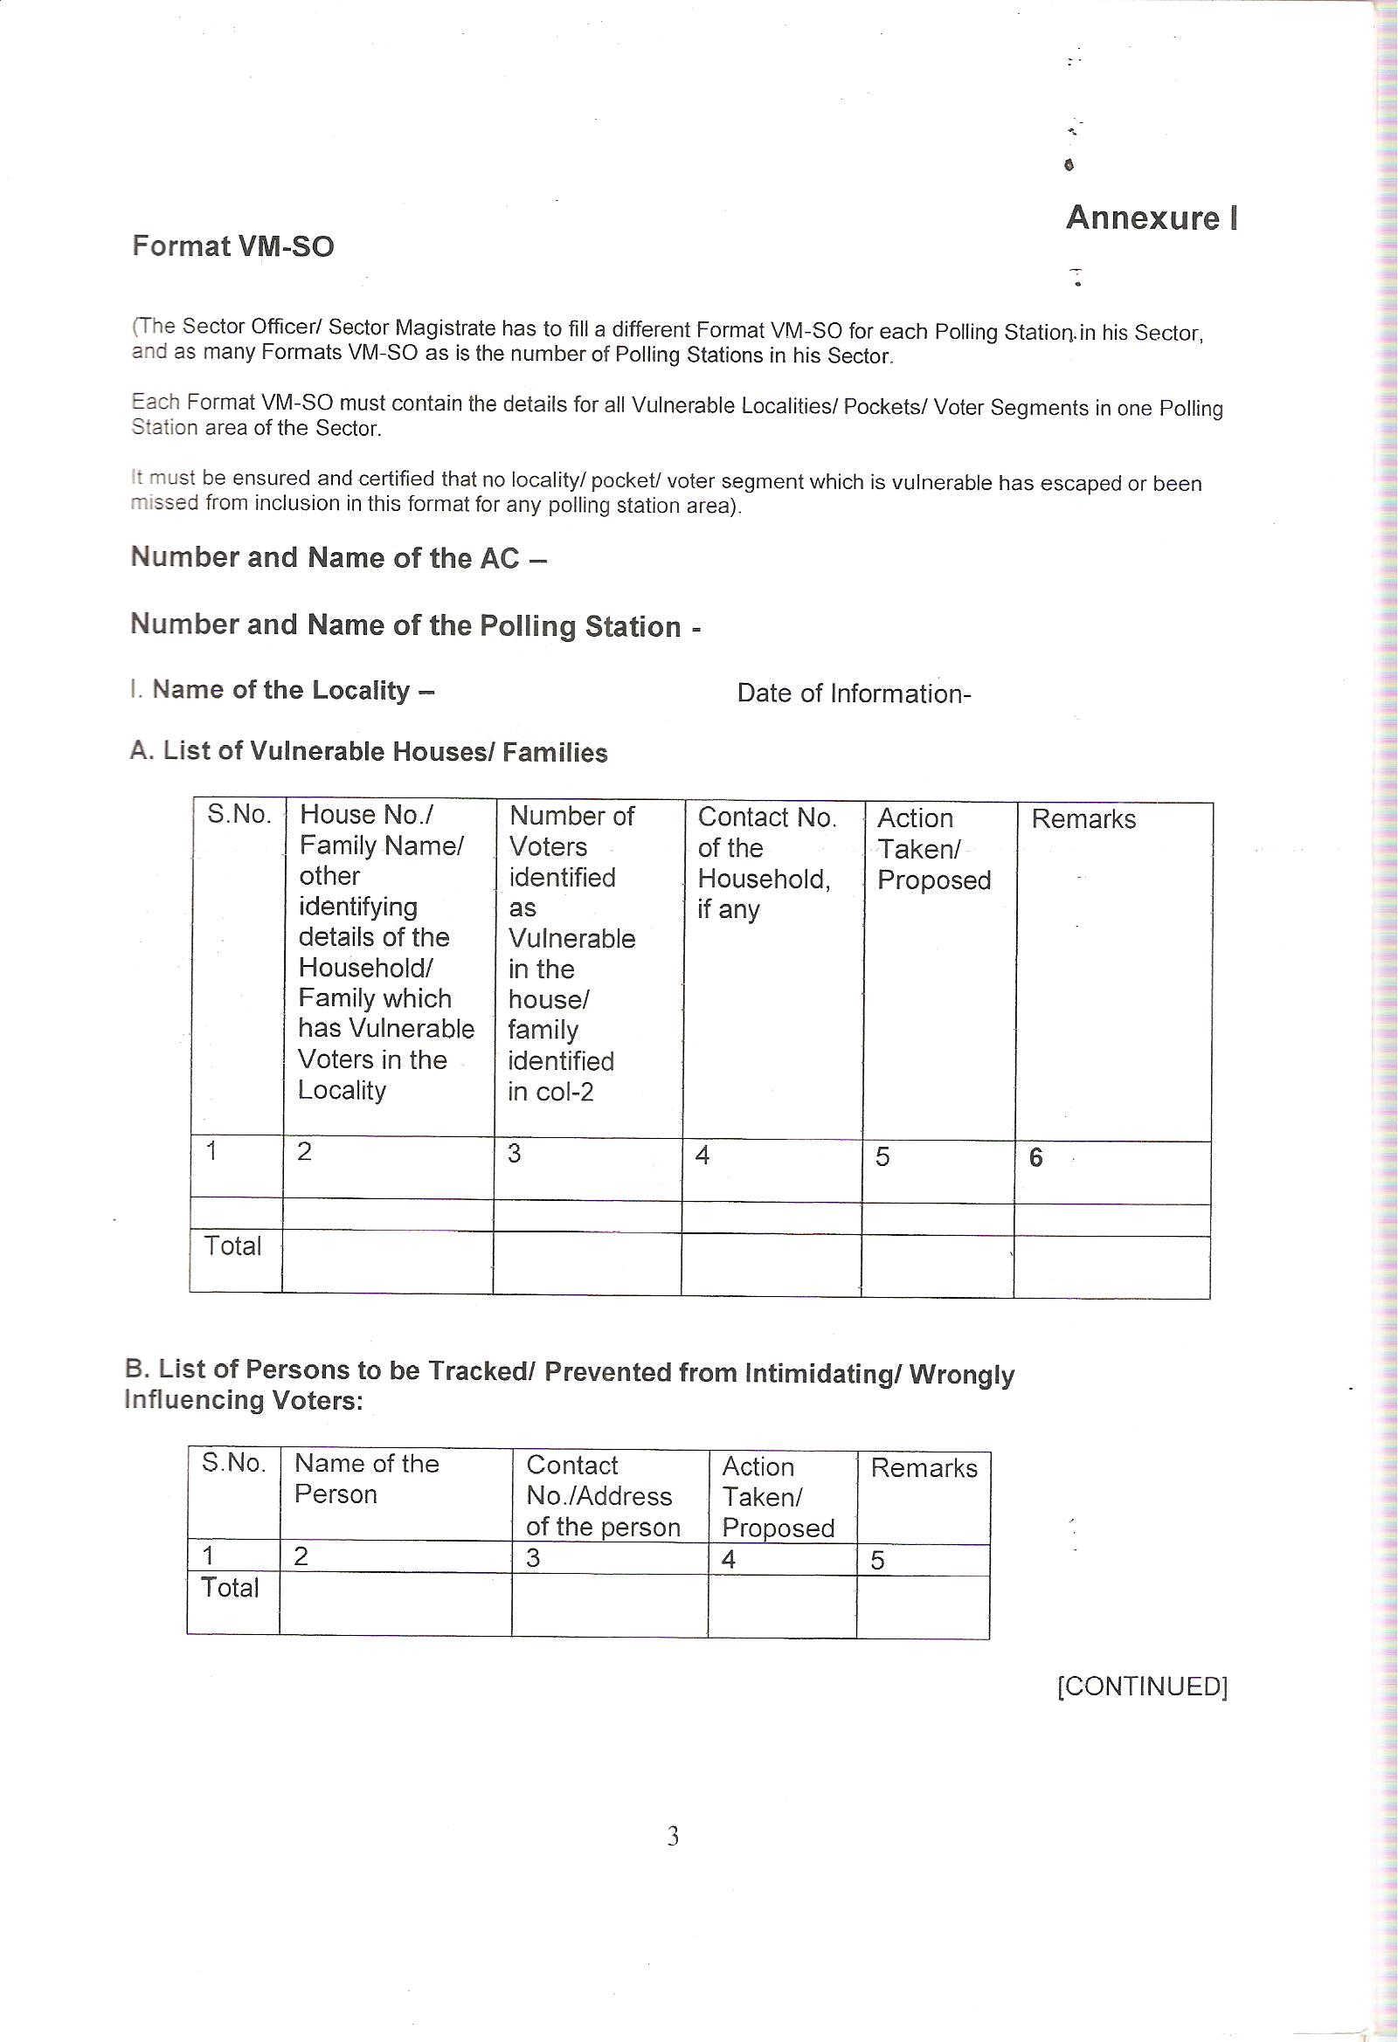
Information for Vulnerability Mapping: VM SO Report
Format for Submitting Information by SO to RO for each locality/ Pocket – Annexure I
Action Taken/Proposed for identified vulnerable houses/families
Action Taken/Proposed against identified persons causing vulnerability

Slide 39
CRITICALITY ANALYSIS
Identify critical polling stations
  Higher number of non-epic electors
  Higher number of missing voters without family linkage
  Polling stations having vulnerable pockets
  Above 90% votes polled out of which above 75% in favour of a particular candidate
  Re-poll reported due to malpractices, and where electoral violence has taken place during last election
TO BE DONE BY DEO/ POLICE TO PROVIDE INPUTS ON 3 & 5

Slide 40
CRITICALITY ANALYSIS
Also to take account of :
PS affected by LWE activity
Rivalry between political parties
Political sensitivity
Pronounced presence of criminals
Communal tension
Caste based tension

Slide 41
ACTION POINTS FOR CRITICAL POLLING STATIONS
  1. CPF deployment
2. Deployment of Micro Observers
3. Deployment of web casting / digital / video camera
  4. Strict enforcement of voting with EPIC/ alternative Identity document
5. Special vigil by the CPF
TO BE DONE BY DEO/ POLICE TO PROVIDE SUPPORT ON 1 & 5

Slide 42
PREVENTIVE MEASURES
Maintenance of law & order
Execution of non-bailable warrants
Prosecution under 107 Cr.P.C to prevent breach of peace & binding down under 116 Cr.P.C
Preparation of list of criminals & habitual offenders
Special drive for seizure of illegal arms/explosives
Surrender of licensed weapons

Slide 43
REGULAR SECURITY/ ANTI-CRIME MEASURES
Enforcement of excise law
Action against bootleggers
Regular checking of ID liquor dens
Regular block raid to arrest persons involved in specific cases

Slide 44
RESTRICTION ON SALE OF LIQUOR
Section 135C of RP Act 1951 provides that no spirituous, fermented or intoxicating liquors or other substances of like nature shall be sold, given or distributed at a hotel, eating house, shop or any other place, public or private, within polling area during the period of 48 hours ending from the hour fixed for closing of poll.
Such period is declared as “dry days”.
No hotel, restaurant, club and other establishment shall be permitted to sell / serve liquor to anyone whosoever on the aforesaid days.
Even licensed shops should not be permitted to do so.
Strict vigilance should be enforced on illegal storage and use of liquor.
(Instruction Sl. No.72,79 & 90. ECI letter No.576/14/ 99-PLN-1 dt.21.8.1999, ECI letter No.464/L&O/2007/PLN-I dated 08.12.2007 & ECI letter No. 576 /1 4 / 2007 / PLN -I dated 28.12.2007)

Slide 45
Roles & Responsibilities of Sector Officers – On the Poll Eve

Slide 46
To ensure availability of polling teams and all election material as per Checklist at their PSs.
To ensure that security force has arrived at PSs according to the plan.
    To match the number of EVMs (CU-BU - serial number and ID number) with allotment order/list by RO for that Polling station.

Slide 47
To clarify any last minute doubts on EVM-VVPAT operation or the polling process, amongst the poll personnel.
To ensure observance of Model Code of Conduct as well as prevent/report/act upon deviations from prohibitory orders enforced during election period.
To mark the 100m and 200m boundary around the assigned polling stations and plan out closure of any camp office and club since P-48 hours within 200 mts and sanitize such area from any political campaign or advertisement.

Slide 48
To report immediately for any missing team/ member of a team to the RO.
To give OK report to control room.

Slide 49
Poll-eve required resources
A videographer to monitor any breach of MCC. (During poll eve and poll day).
Additional Tender ballot paper for contingency.
Police Personnel
Polling Materials for each polling stations

Slide 50
Roles & Responsibilities of Sector Officers – On the Poll Day

Slide 51
Poll day responsibility
To observe the implementation of provisions of Model Code of Conduct in and around the PSs in the sector
To be present at any one of the polling stations assigned to him when mock poll procedure is carried out
To ascertain the mock poll status before commencement of poll- remedial action to sort out problem, if any
Mock poll certification be ensured and mock poll status be reported immediately to RO

Slide 52
To ensure the poll process starts at given time at all PSs and report commencement of polls without any delay
To make frequent visits and pay attention to the PS where the mock poll had to be conducted in the absence of agents
To ensure that security forces deployed at PSs are in position

Slide 53
Report voting percentage from time to time to RO as instructed
To ensure availability of spare EVM-VVPATs for replacement
To ensure replacement of EVMs, if and when required, within the shortest possible time
Handling of poll day complaints

Slide 54
To track and report the presence/ absence of polling agents
To assist polling team inside polling station with procedures
To maintain the purity of poll process and check all aspects of polling during their visits to PSs
Ensure entry of every visitor in the visit sheet at each polling station
To pay special attention on the day of poll to verify whether voters from the vulnerable habitats/ communities are turning up for voting or not and inform RO for remedial measures

Slide 55
Replacement of polling personnel from reserve parties if required
Provide inputs to Presiding Officer, Polling Officer
To ensure that the procedure of sealing of Papers & EVM etc. done properly in all PSs at the close of Poll
To ensure the closing of register form 17A as per ECI instructions.

Slide 56
At the end of poll he will ensure that: -
(a) Presiding Officer Diary is filled up properly
(b) EVMs are properly sealed.
(c) Copies of 17C are given to polling agents
(d) Register of 17A is properly filled up.
Format for Pro's additional report to be submitted to Observer is filled up properly.

Slide 57
The Sector Officer is to provide an ‘okay’ report on the conduct of polls at the end of Poll.
The Sector Officer is to escort and ensure the deposit of EVM-VVPATs at designated counters.

Slide 58
List of stationaries & materials required during poll-day
Control Unit – 1 & Ballot Unit (as per no. of candidates)
VVPAT
Register of Voters (Form 17A)
Voter’s Slips
Working Copy and Marked Copy of Electoral Roll-3
List of Classified Service Voters, if any

Slide 59
List of stationaries & materials required during poll-day
Address tag for CU/BU
Address Tag for VVPAT
Special Tag
Green paper Seals for EVM
Ballot Papers for Tendered Votes- 20
Indelible Ink- 2 Phials of 10CC each

Slide 60
List of stationaries & materials required during poll-day
Strip Seal
Metal Seal for Presiding Officer
Match Box
Presiding Officer’s Diary
Distinguishing Mark Rubber stamp
Rubber Stamp Arrow Cross Mark
Stamp Pad (purple)
Presiding Officer’s Declaration

Slide 61
List of stationaries & materials required during poll-day
List of Contesting Candidates
List of Challenged Votes (Form 14)
List of Blind and Infirm Voters (Form 14A)
List of Tendered Votes (Form 17B)
Account of Votes Recorded (Form 17C)

Slide 62
List of stationaries & materials required during poll-day
Receipt Book for deposit of challenged votes fee- 1 book
Letter to SHO
Declaration by the Presiding Officer (Part I to IV)
Declaration by Elector about his age
Presiding Officer’s Diary

Slide 63
List of stationaries & materials required during poll-day
List of Electors who voted after giving declaration/refused to give declaration
Declaration by the companion of blind and infirm voters
Passes for Polling agents
Visit Sheet
Format for Presiding Officer’s Additional 16-Point report to be submitted to Constituency Observer/ RO

Slide 64
EVM-VVPAT Operations

Slide 65
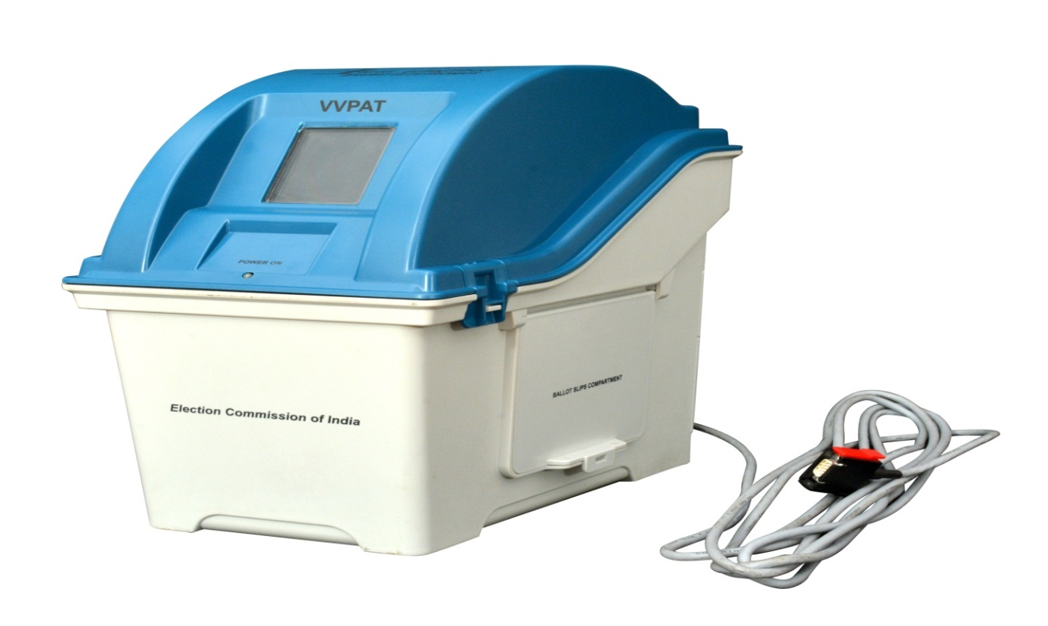
VVPAT
Features of
M3 VOTER VERIFIABLE PAPER AUDIT TRAIL
(VVPAT - M3)

Slide 66
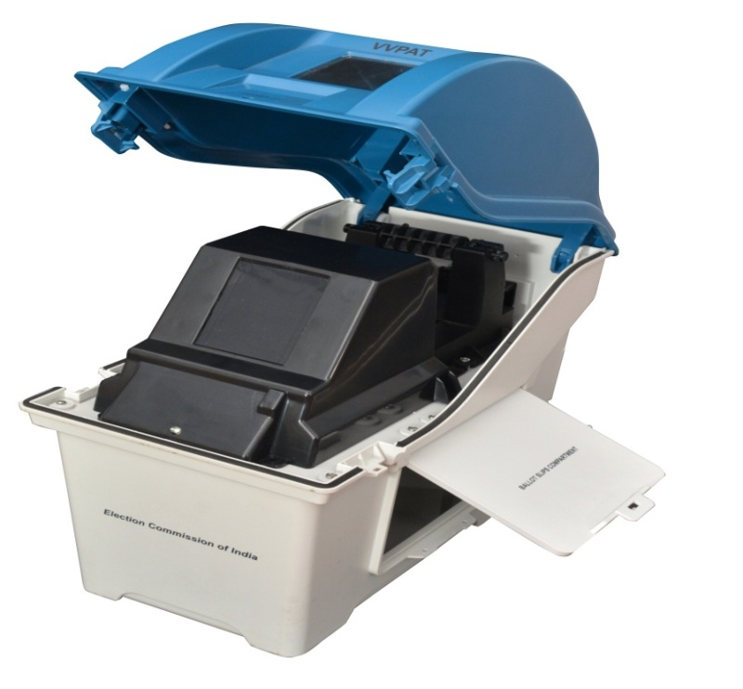
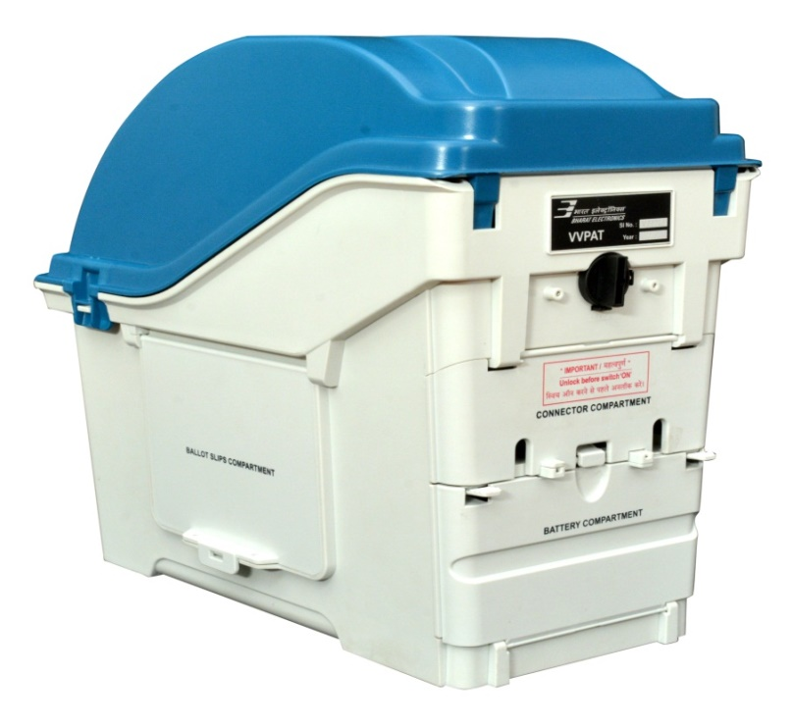
VVPAT- features
VVPAT system consists of four independent compartments,
namely :
(i) Paper roll compartment (ii) Ballot slips compartment
(iii) Battery compartment (iv) Connector compartment
Special Features of the VVPAT

Slide 67
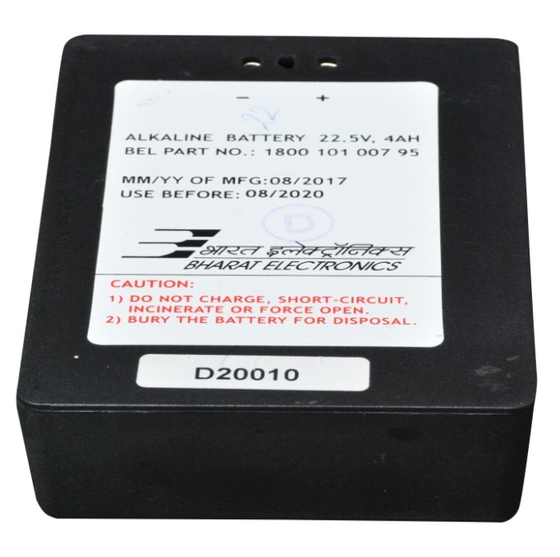
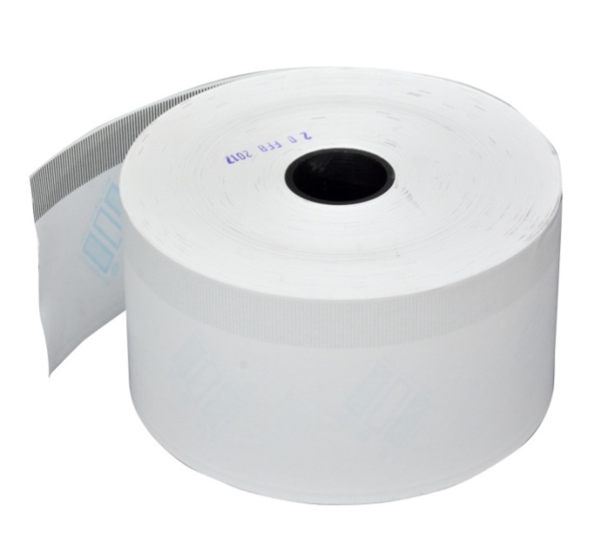
VVPAT- features
Prints the ballot slip of size 56 x 99 mm
Operates on a battery pack (22.5 V / 4 Ah)
Accommodates paper roll of length 150 meters or less
Special Features of the VVPAT

Slide 68
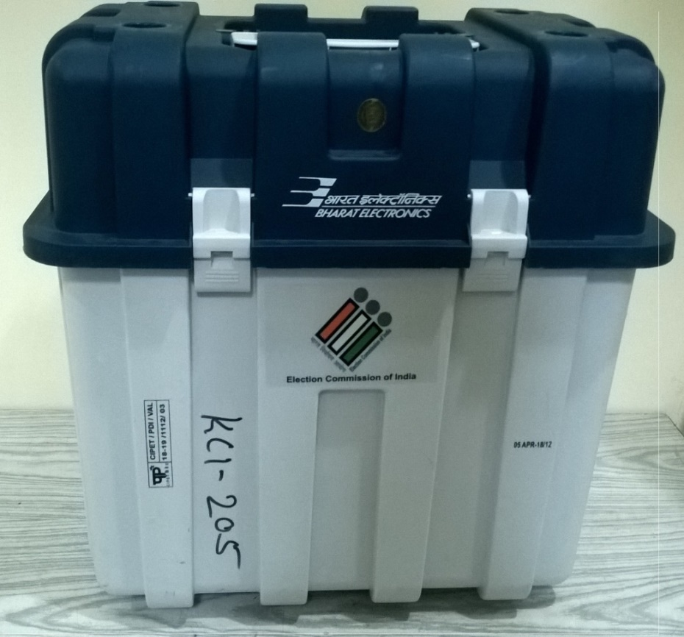
VVPAT – Carrying Cases
Carrying Case - VVPAT
VVPAT is packed separately in special carrying cases
To Open the Carrying case, Lift front and side latch

Slide 69

VVPAT – Front View
Transparent Window
Power ON LED
Ballot Slip Compartment
The Interconnecting cable is permanently attached to the VVPAT Unit
Front View

Slide 70
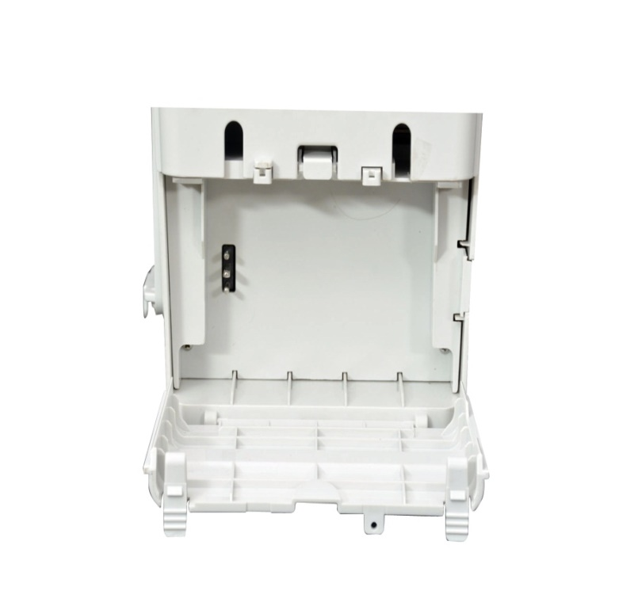
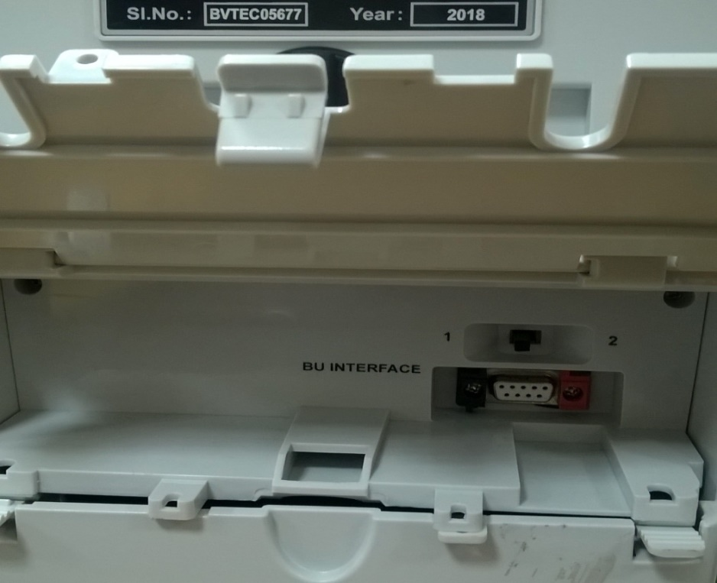
VVPAT– Rear View
Connector and Battery Compartment
Battery
Compartment
Connector
Compartment
BU interface
Battery Plug
VVPAT Position Switch

Slide 71
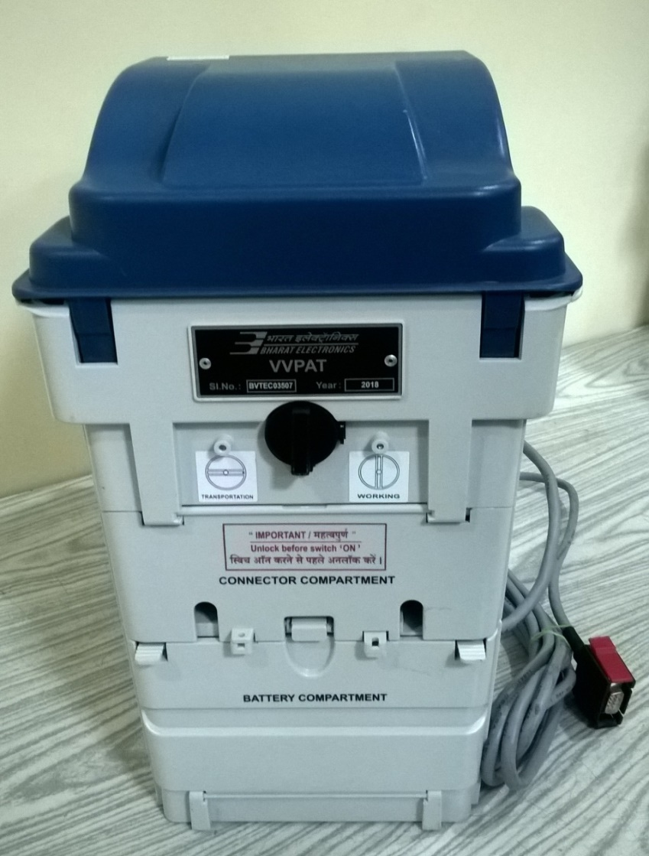
VVPAT–Rear View
Lock-Unlock Knob
Keep know vertical while using VVPAT
Keep know horizontal while
transporting VVPAT
Stickers for Indication

Slide 72
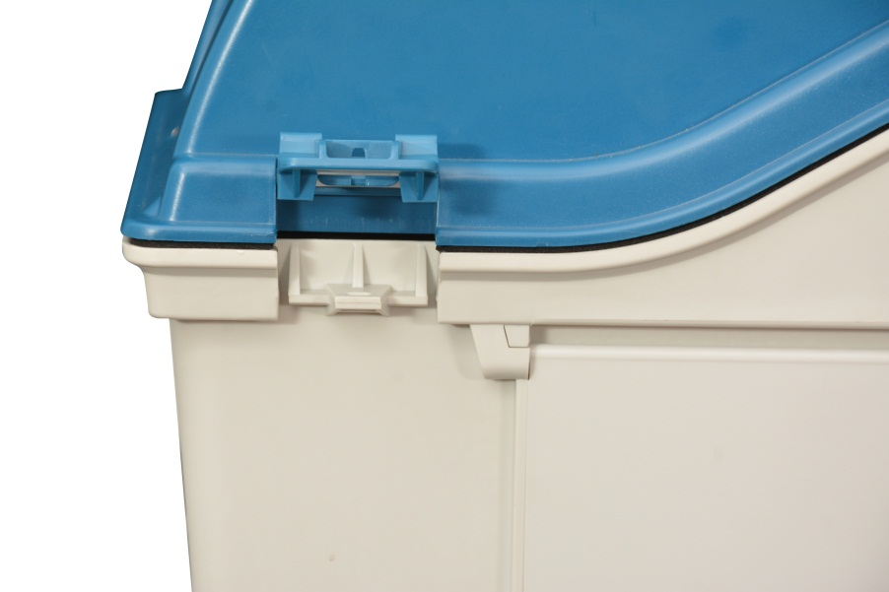
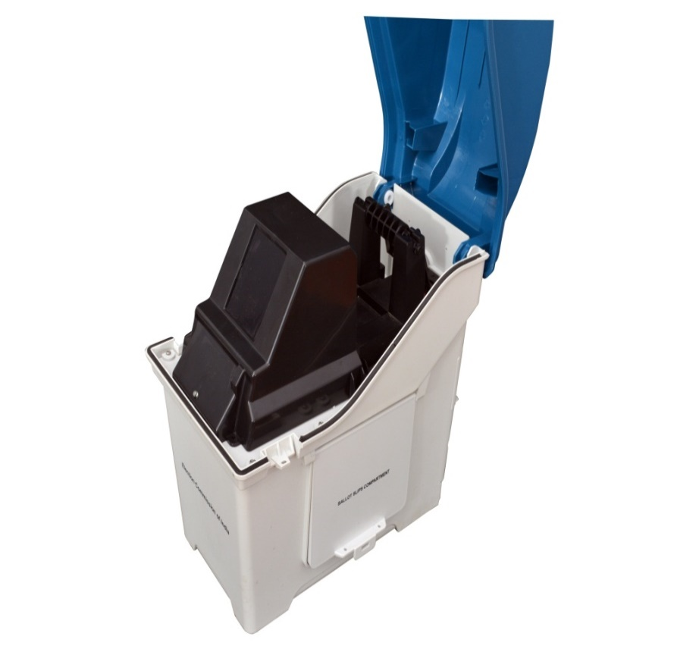
VVPAT – Opening of Paper Compartment
Lift side Latch to
open Compartment
Paper Compartment
after opening

Slide 73
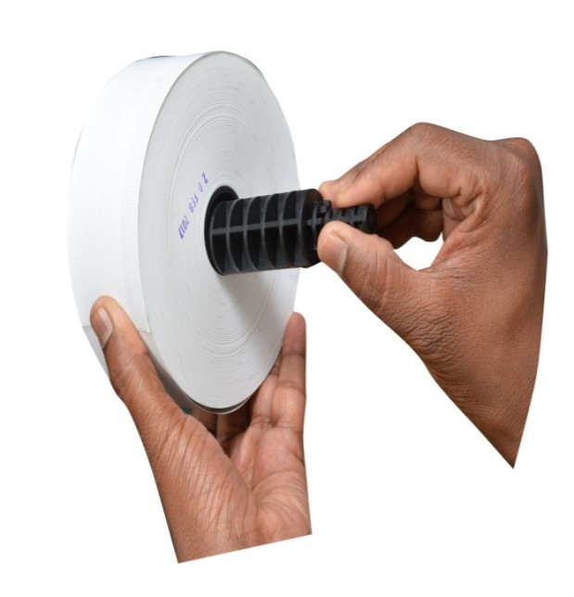
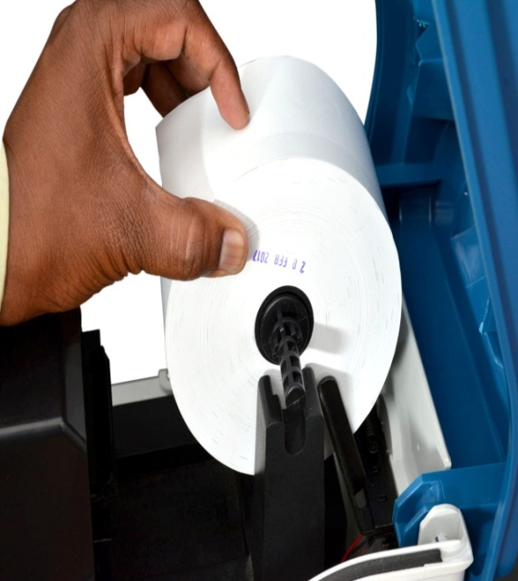
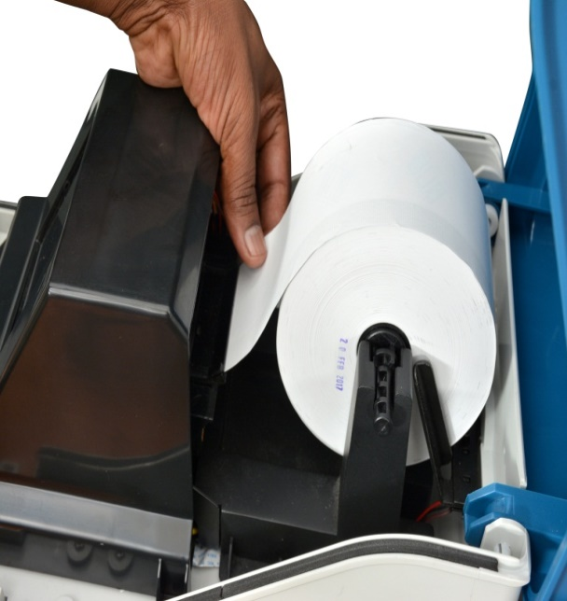
VVPAT
Loading of Paper Rolls
Insert spindle into
Paper Roll
Press down Paper Roll into space provided
Insert Paper into
Paper Guide

Slide 74

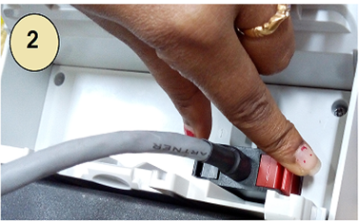
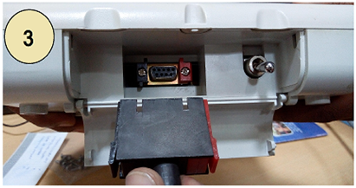
VVPAT Connection
Open connector compartment of VVPAT
Connect cable from Ballot Unit to BU Interface connector matching the coloured latches (red/black connector)
Connect VVPAT cable to BU interface connector of Control Unit matching the coloured latches (red/black connector)

Slide 75
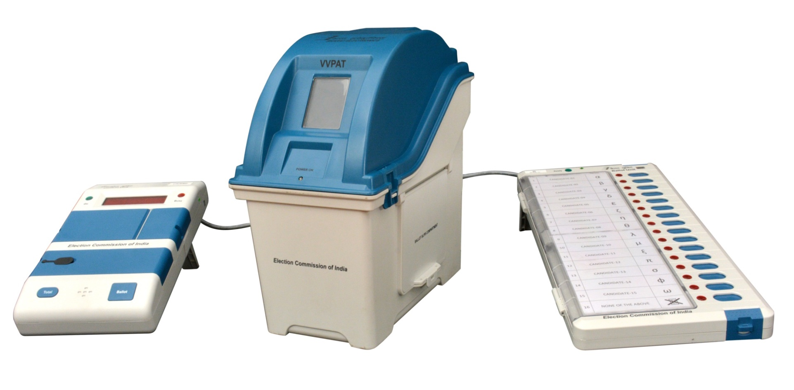
VVPAT
VVPAT setup with CU and BU

Slide 76
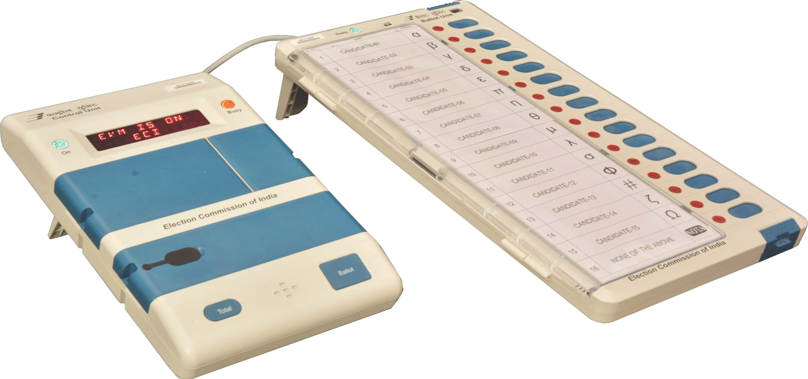
Components of EVM

Slide 77

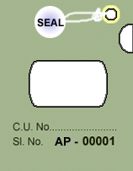
EVM – Seals/Tags used
Election To: (Lok Sabha or Legislative Assembly)
From: (No. and Name of)
Constituency
Control Unit/ Balloting Unit No.: (ID number)
Serial No. & Name of
Polling Station Where Used ……..…….… …
Date of Poll:………………………………………
Address tag with sealing thread
Green Paper seal for sealing Result and Print windows
Front
Rear
Special tag for sealing Result section inner compartment
Upper Side
Outer Paper Strip Seal
(23.5” X 1”)
A
B
D
Lower Side
C
Pre-gummed portion with wax paper

Slide 78
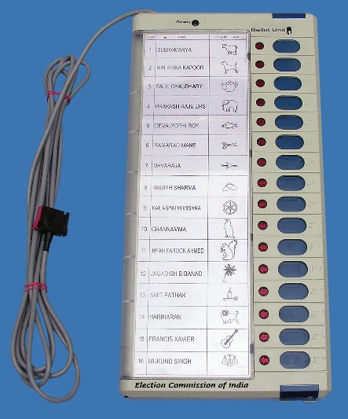
Various Component of EVM - Balloting Unit
This is the unit the voter operates to exercise his / her franchise
The Interconnecting cable is permanently attached to the Balloting Unit

Slide 79
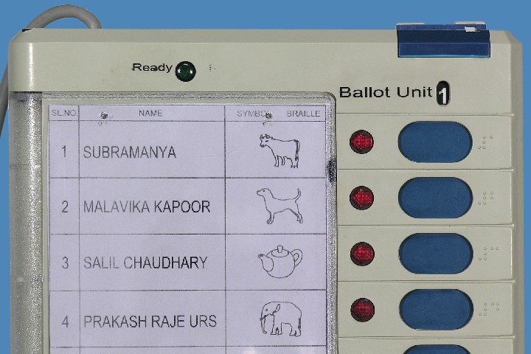
Various Component of EVM - Balloting Unit Detail
Interconnecting Cable
Slide Switch Window
Ready Lamp (Green)
Numbers in Braille
Candidate’s Button
Candidate’s Lamp
Ballot Paper Screen

Slide 80
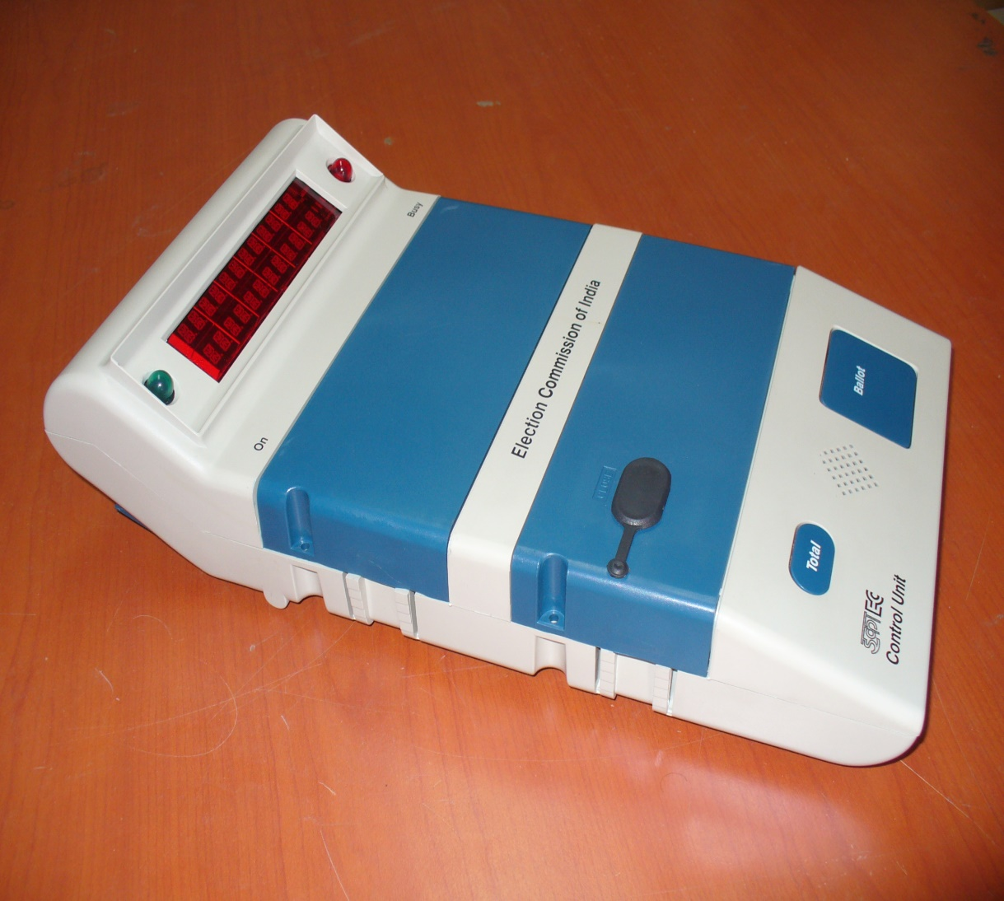
Various Components of EVM – Control Unit
Busy Lamp (Red)
Display Section
Candidate Set Section
Result Section
Ballot Section
Power ON Lamp (Green)

Slide 81
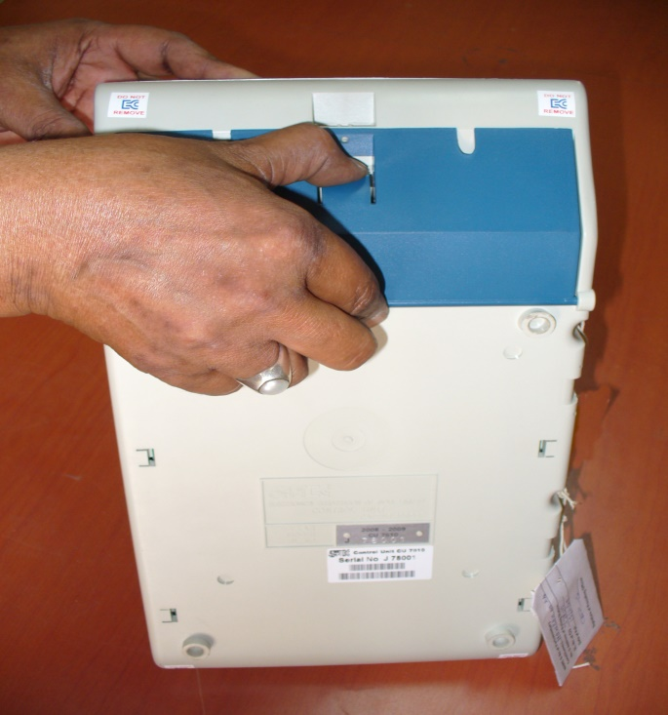
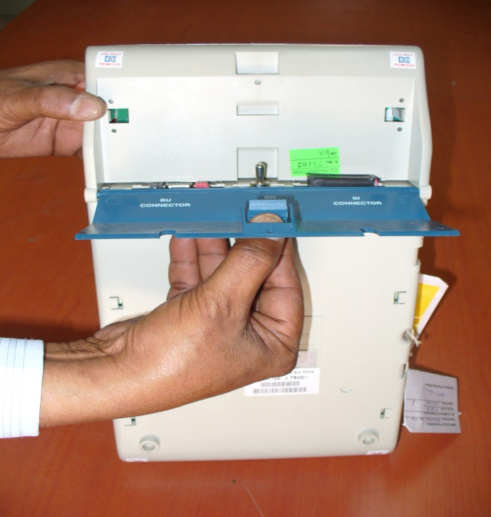
Various Components of EVM - Control Unit – How to open
Press Latch to release
Bottom Compartment Cover
Pull to open cover

Slide 82
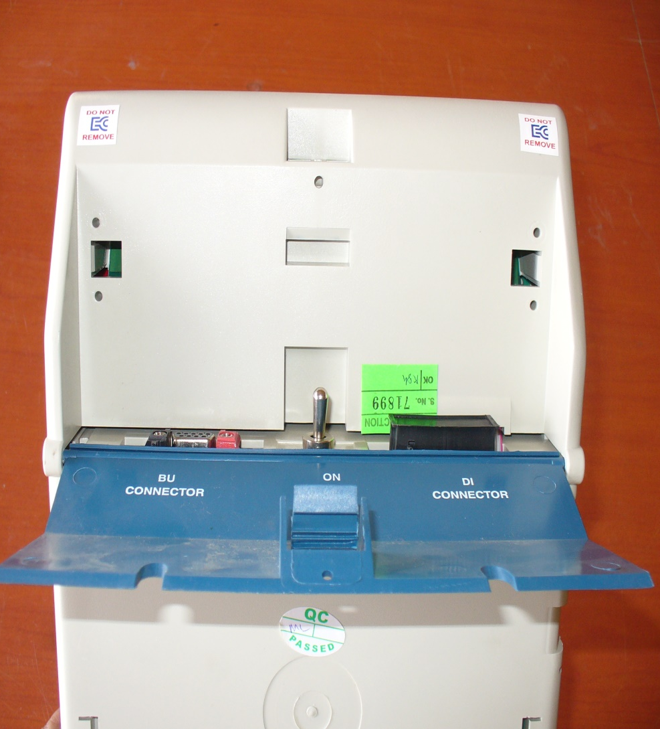
Various Components of EVM – Control Unit – Back side detail
Power Switch
Socket for connecting Data Interface.
Socket for Interconnecting Cable
of Balloting Unit

Slide 83
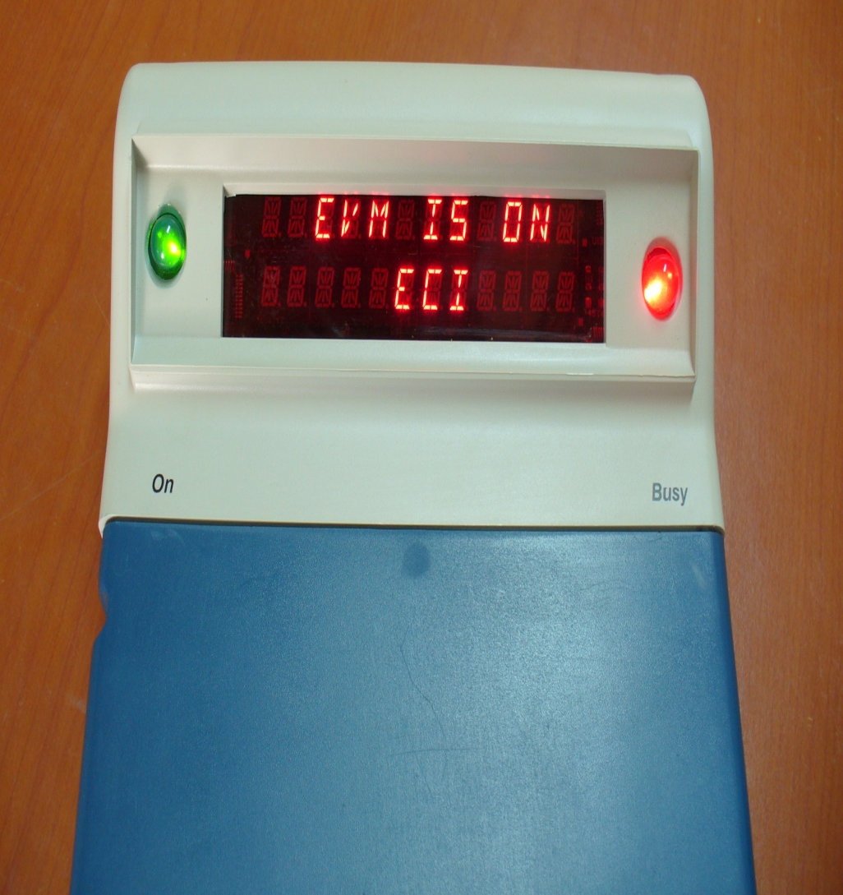
Various Components of EVM – Display Section
Busy lamp glows ‘RED” when the ‘Ballot’ button is pressed by polling officer to enable the voter to cast vote. It goes off when the voter has cast his vote.
When no button is operated for 10-15 minutes, the CU goes to power save mode. Indicated by flickering of green ‘ON’ lamp in every 5 seconds.
Busy Lamp (Red)
Dual Line Digital Display Panel
Power ON Lamp (Green)

Slide 84
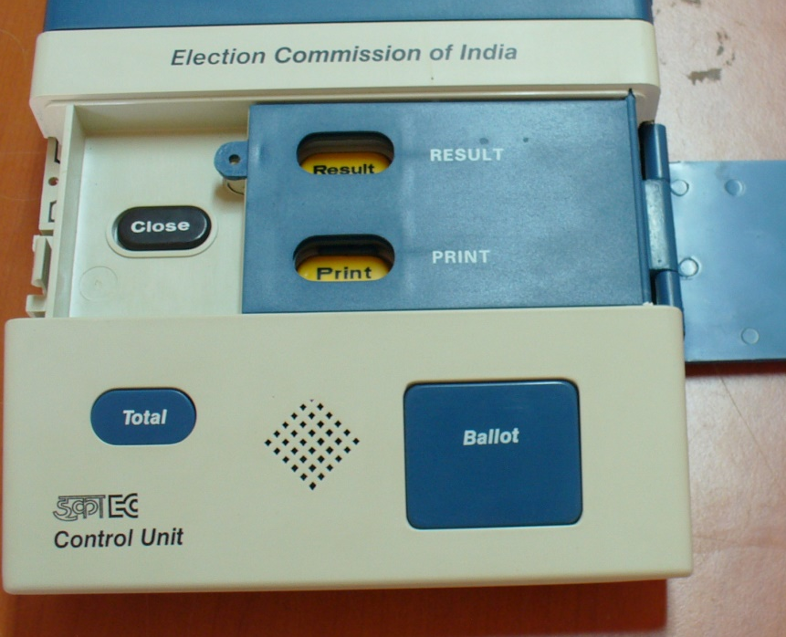
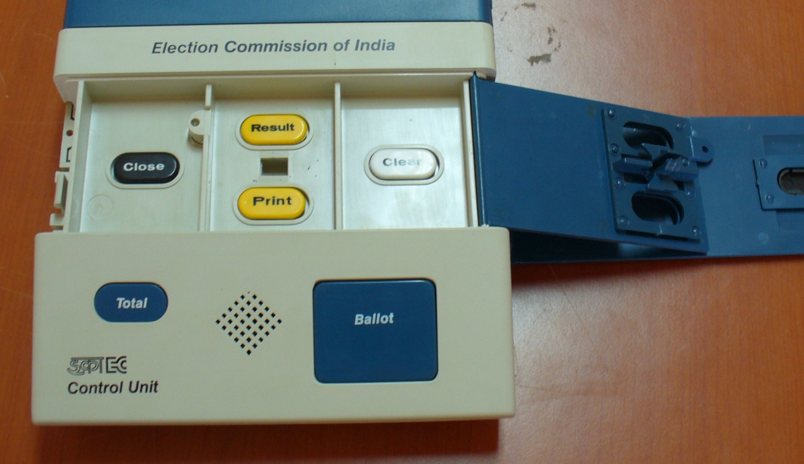
Various Components of EVM – Control Unit - Result Section
Close Button
Result Section
Outer Door
Result Button
Clear Button
Frame for Paper Seals
Holes to pass thread for sealing
Inner Compartment Door
Print Button
Inner Latches
Outer Door

Slide 85
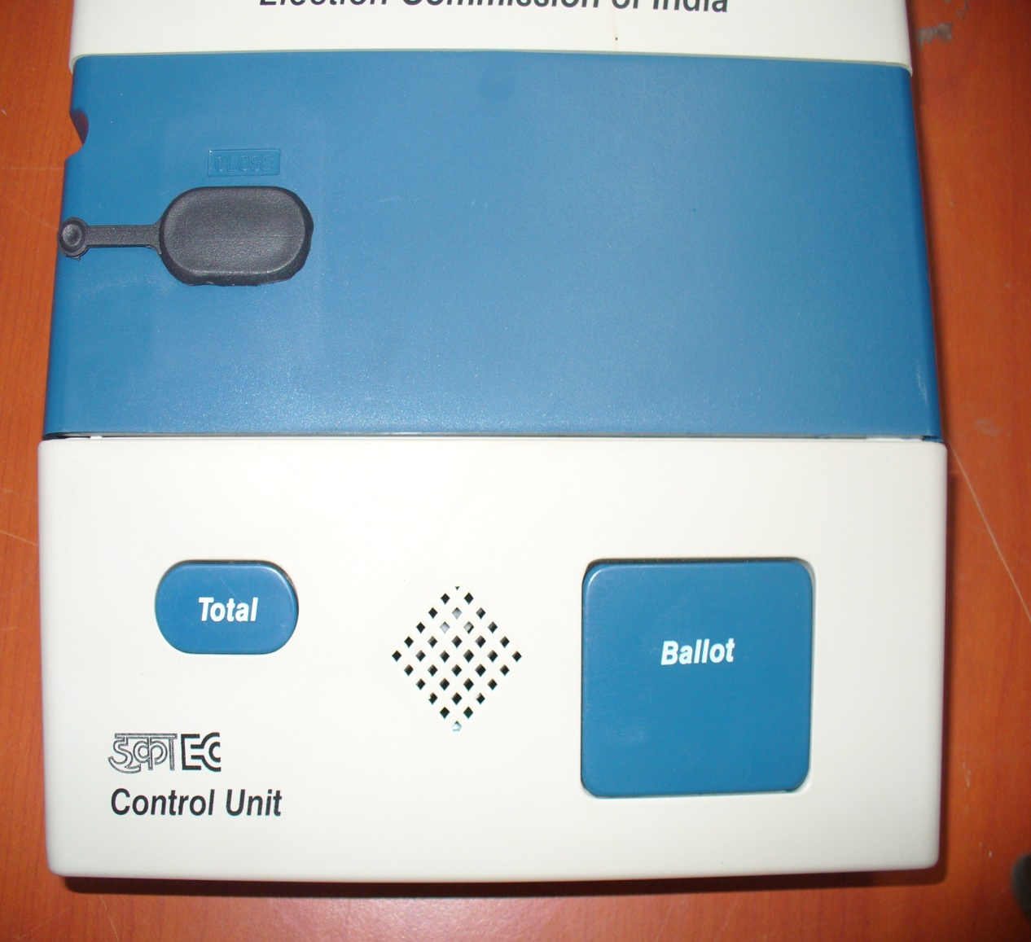
Various Components of EVM – Control Unit - Ballot Section
Total Button
Buzzer
Ballot Button

Slide 86
Verification of EVM after receiving from DC
Each BU & CU will have green stickers at the back with following details
Name of the State/UT:
Name of the Election:
District Name:
Control Unit No. |  | District Running Serial
Current ID
First Level Check |  |  |  | CU Randomization 1
Date | Rep. ECIL |  | Rep. DEO | Date |  | Rep. RO
Rand. 2 | Deployment Status |  | Polling Station No. |  |  | R.O./ A.R.O.

Slide 87
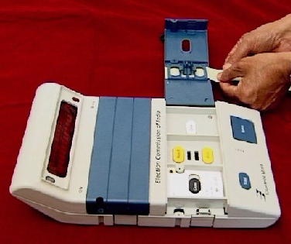
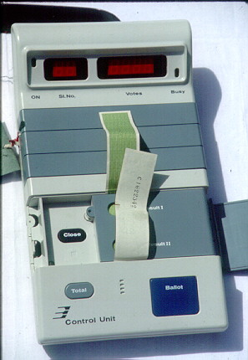
EVM – Sealing – Presiding Officer
Insert the Green Paper seal in the frames provided for both Result
Close the Result Section inner compartment door with the Green paper seal protruding outside
Result
Print

Slide 88
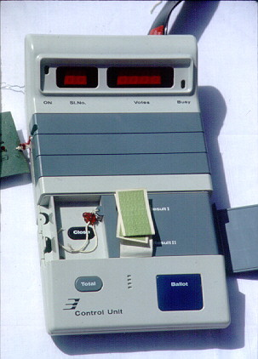
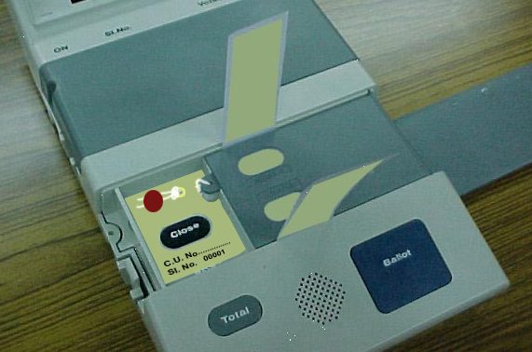
EVM – Sealing – Presiding Officer
Seal the Result Section inner compartment
Result
Print
Fix the Special tag such that the button is visible and seal the tag
Close

Slide 89
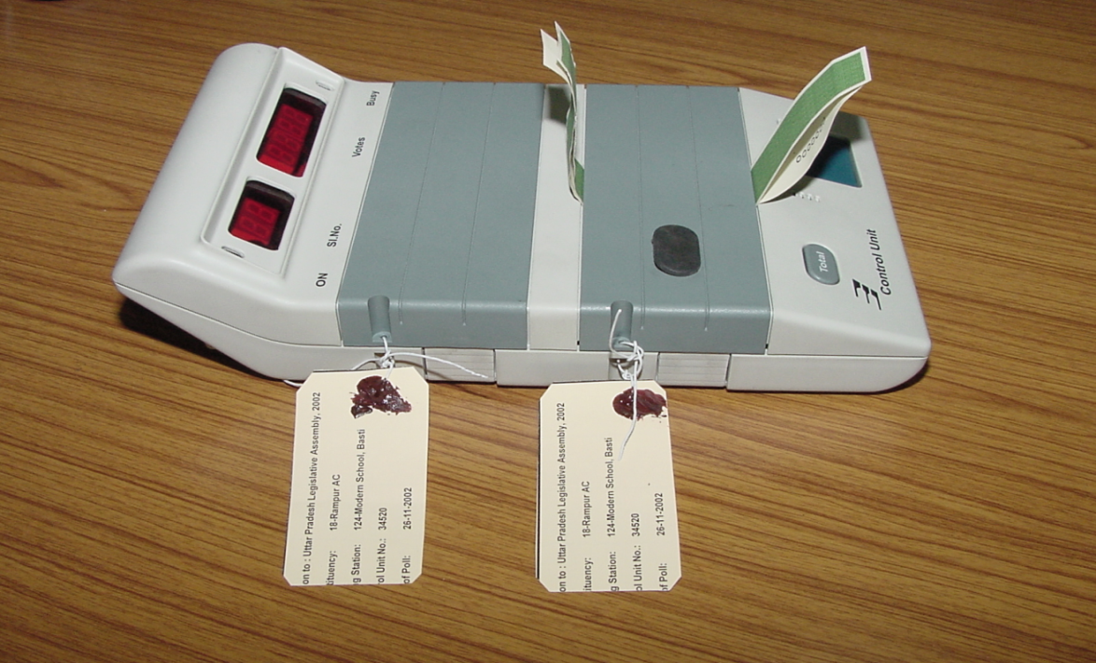
EVM – Sealing – Presiding Officer
Close the Result Section door such that the Green paper seal protrudes outside and Seal the door along with the Address tag

Slide 90
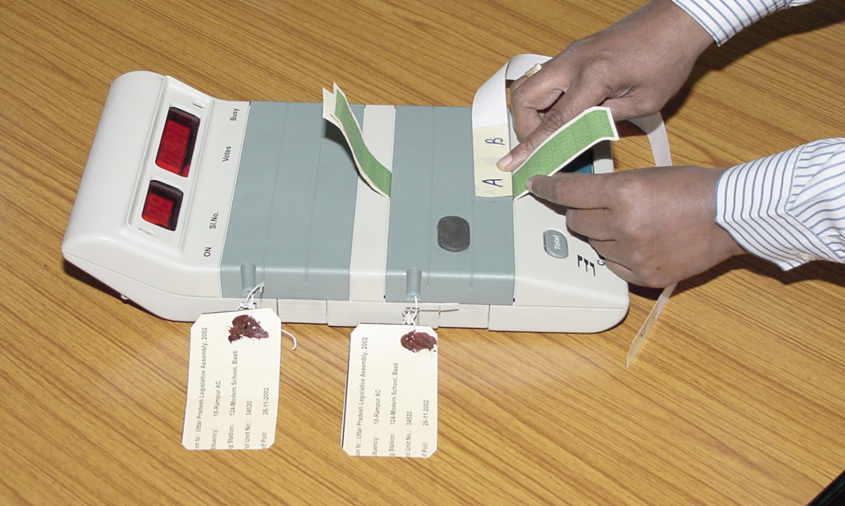
EVM – Sealing – Presiding Officer
Fixing the Outer Paper Strip Seal
A
B
D
Keep the Strip Seal with pre-gummed portion ‘A’ near the base of the Green Paper Seal protruding from the lower end of the door.
Remove the wax paper covering ‘A’ and paste the lower layer of Green Paper Seal.

Slide 91
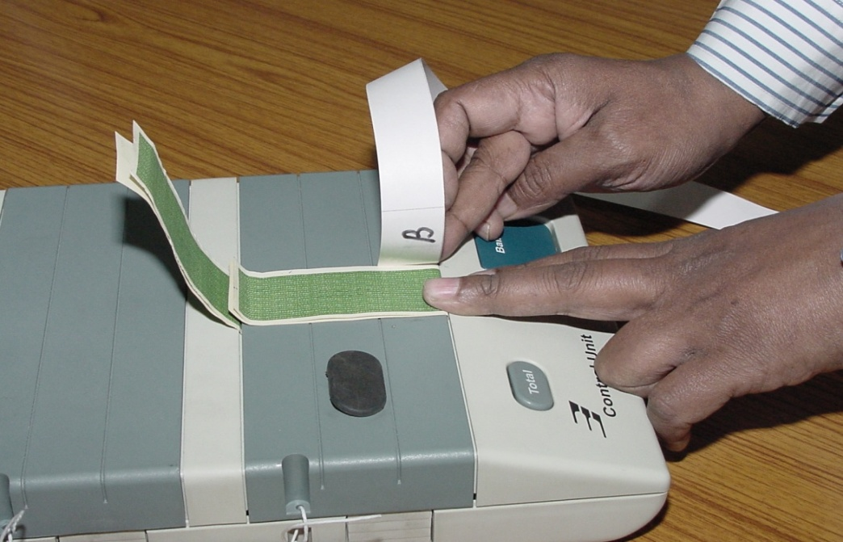
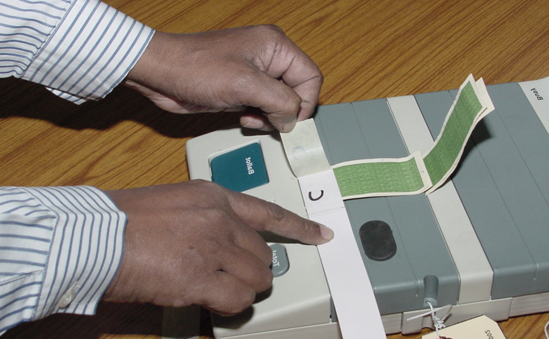
EVM – Sealing – Presiding Officer
Remove wax paper covering ‘B’ and paste it above the upper layer of the Green Paper Seal.
After pasting ‘B’, the pre-gummed portion ‘C’ will be on top. Remove wax paper over ‘C’

Slide 92
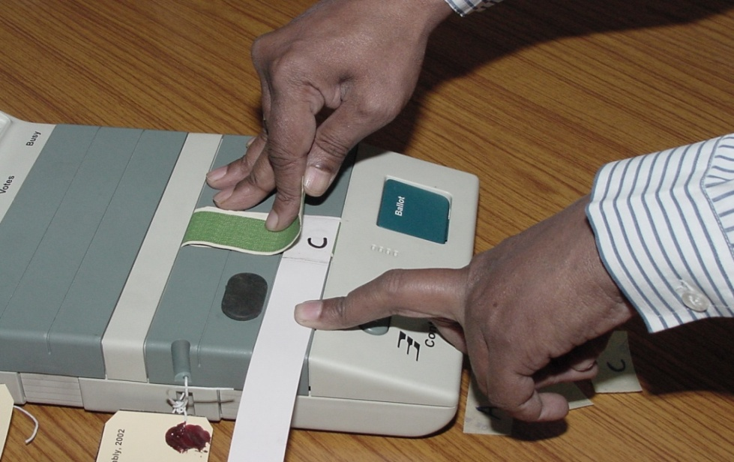
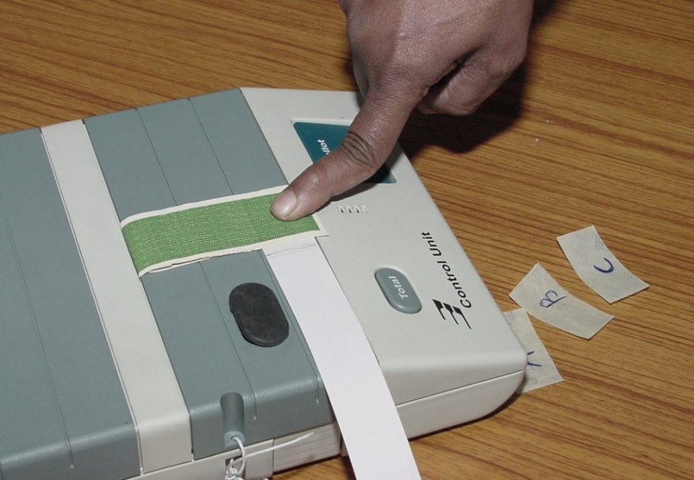
EVM – Sealing – Presiding Officer
Press both the layers of Green Paper Seal protruding from the top and….
Paste the lower layer by pressing it on ‘C’.

Slide 93
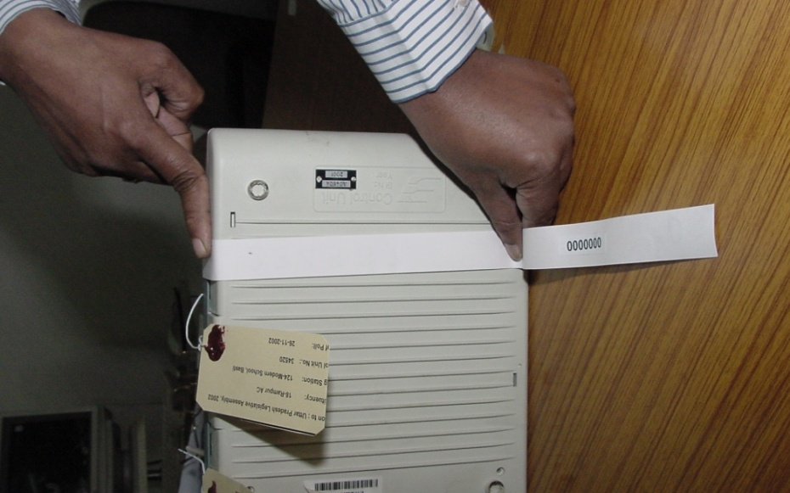
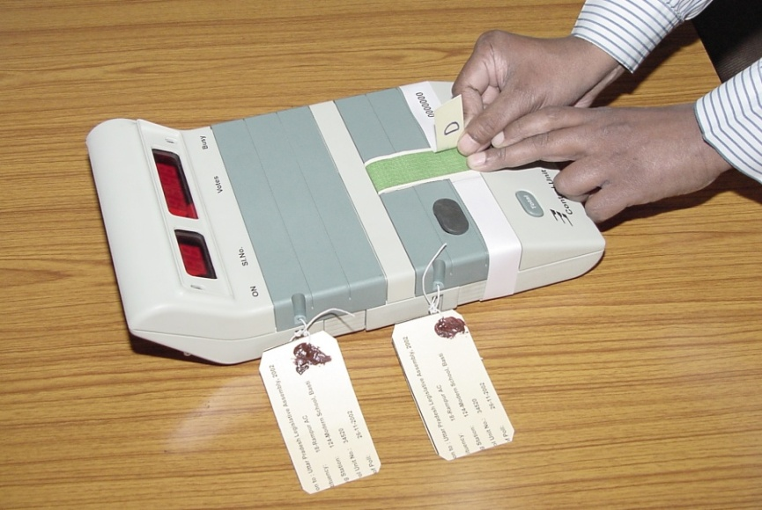
EVM – Sealing – Presiding Officer
Take the Strip Seal round the Control Unit from left side just below the CLOSE button window
Bring the other end of the Strip Seal from right side to the top. Now the pre-gummed portion ‘D’ will be on top.
Remove the wax paper over ‘D’ and paste it on top of Green Paper Seal.

Slide 94
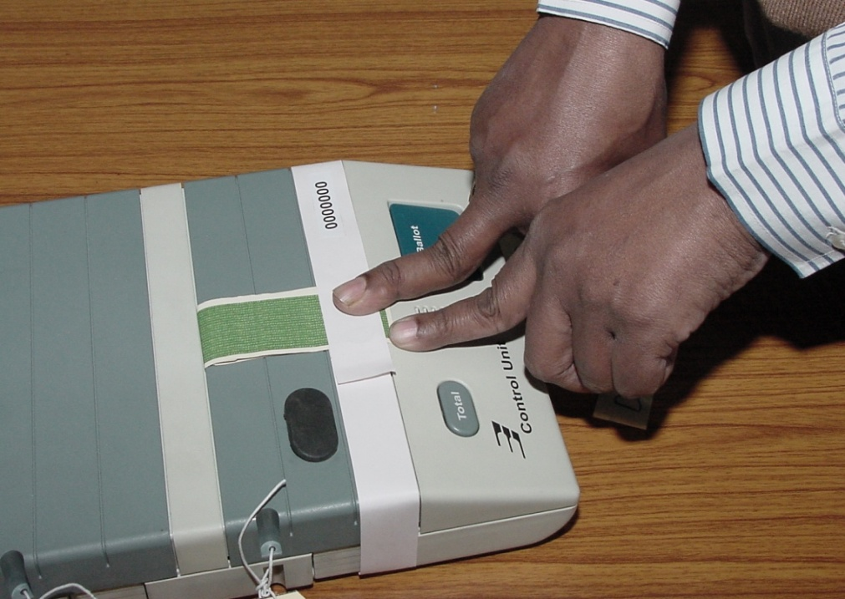
EVM – Sealing – Presiding Officer
Now the Strip Seal is finally fixed. Note that the Strip seal does not cover CLOSE button Flap. Control Unit is now ready to take real poll.

Slide 95
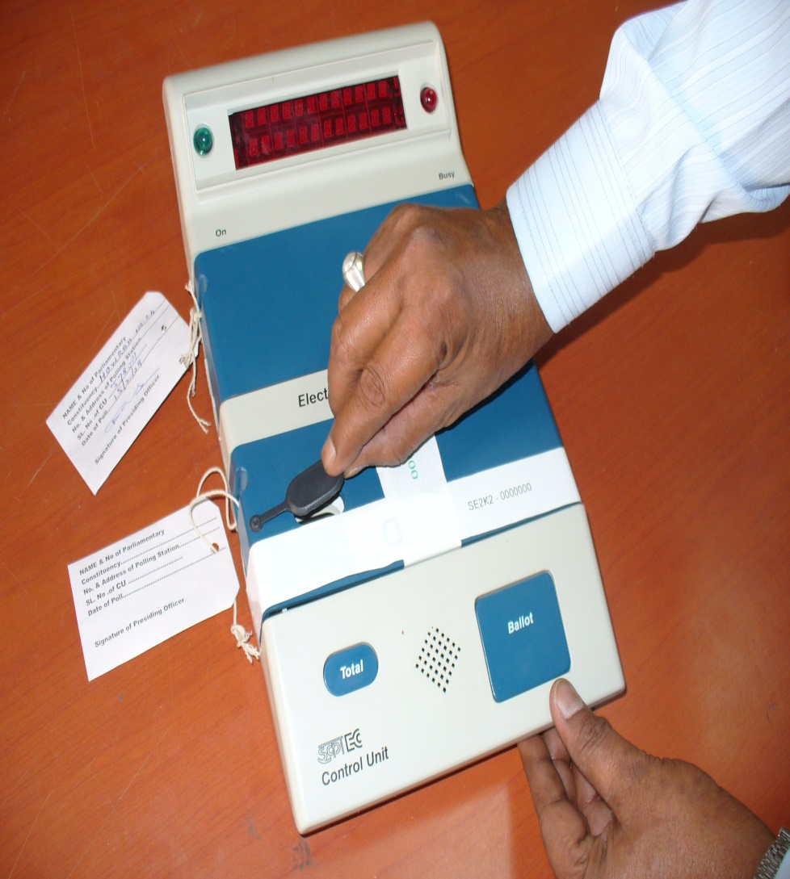
How to close & seal EVM after poll
After the Close of POLL, remove the cap on Close button in the Control Unit.

Slide 96
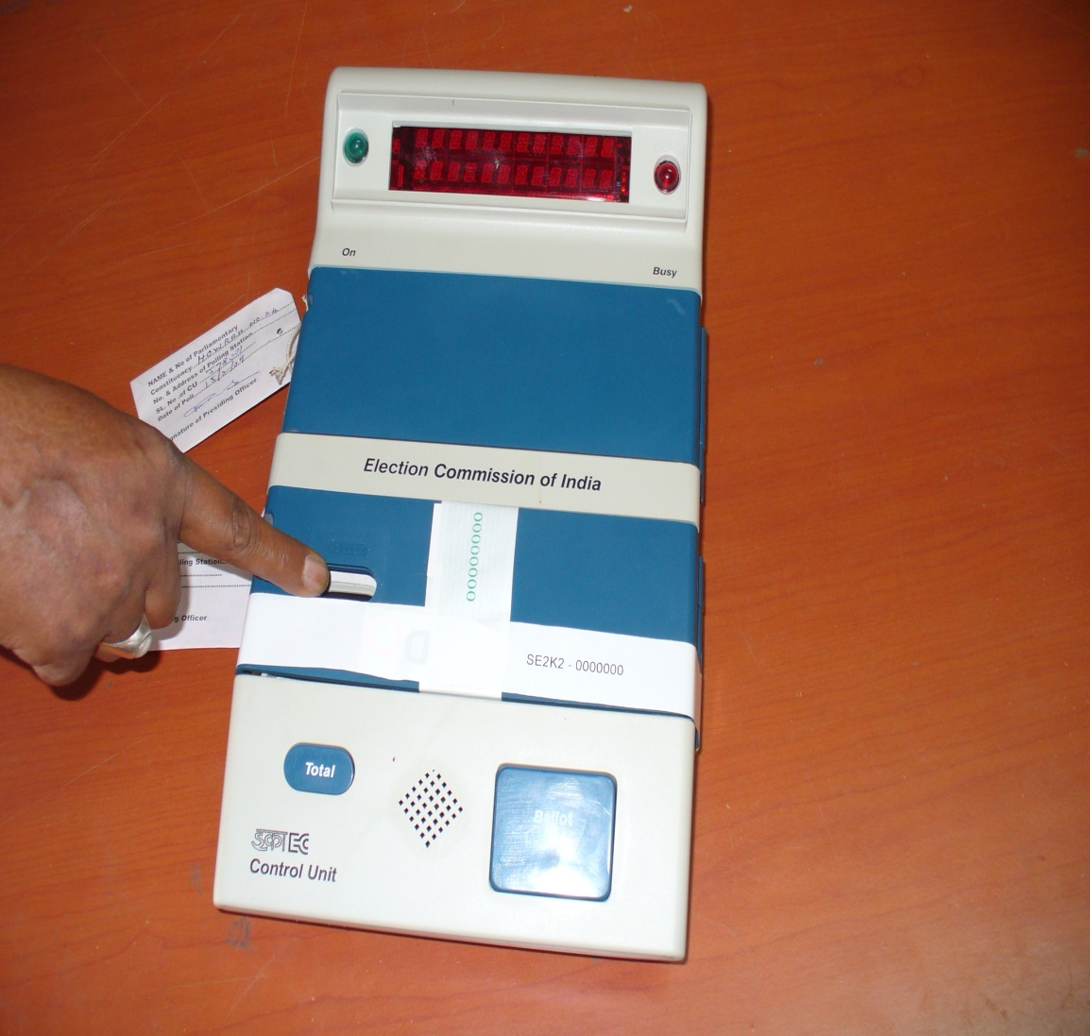
How to close & seal EVM after poll
Press the button as shown.
Poll is closed
Fix the cap back in its
The Control unit displays total no. of votes recorded.

Slide 97
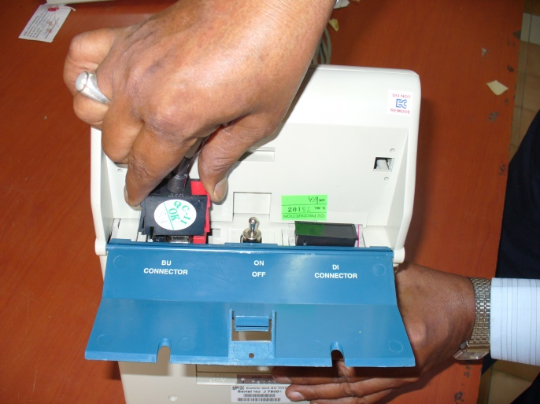
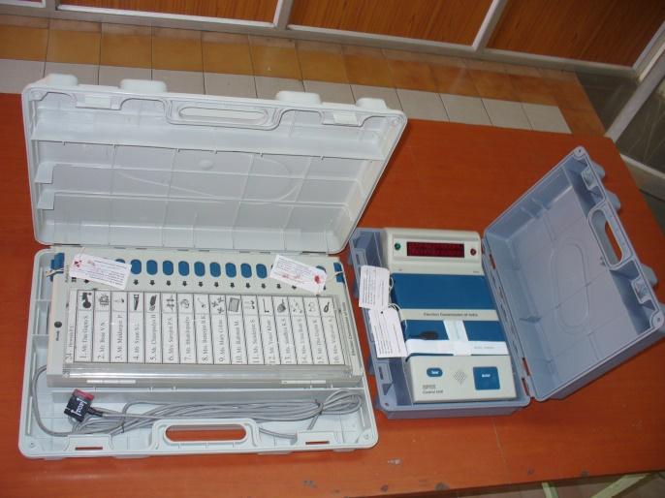
How to close & seal EVM after poll
Open the bottom compartment of the Control Unit and Switch OFF Power and disconnect the interconnecting cable
Pack the Control unit (with the Strip seal) and Balloting Unit in their carrying cases

Slide 98
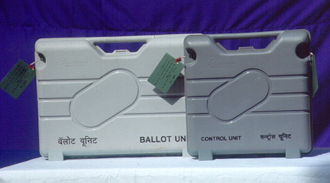
EVM – Sealing – Presiding Officer
Sealing after the CLOSE of Poll
After CLOSING the Poll, place the Control Unit and Ballot Unit in their carrying cases, close and seal with the Address tag

Slide 99
Reports to be furnished by Sector Officer

Slide 100
Reports
Sector Officer shall submit tour report to RO and DEO for every field visit undertaken by him after his appointment on the lines of the enclosed Format-1 & 2
Sector Officer shall also submit report in Format-3 issued by Election Commission of India giving details about the poll day activities after the polling is over. This report will be submitted to RO.

Slide 103
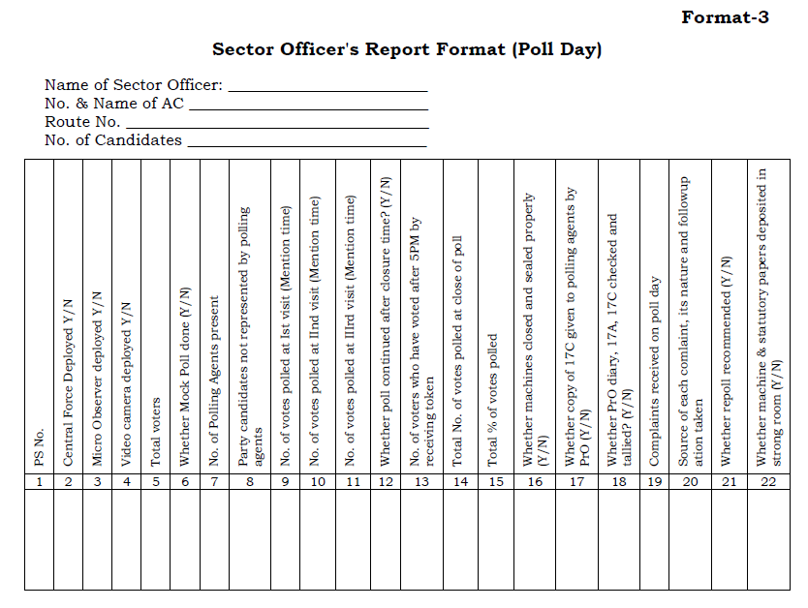

Slide 104
Thanks

